Slide 1
Business Modelling
Sequence Diagrams
Mitali Hora
"Copyright Practical OO Analysis, Thomson Publishing, 2005".

Slide 2
Sequence Diagram
A sequence diagram shows how objects interact with each other over time in a system. It helps visualize the order of messages and operations between objects.
Illustrates interactions and message flows between objects
Shows the sequence of operations over time
Helps understand use cases, design system architecture, and document processes
"Copyright Practical OO Analysis, Thomson Publishing, 2005".

Slide 3

Major Ingredients of a Sequence Diagram
1: enquiresAvailability
Message
Self Message
Focus of Control
Steps in the
Sequence
Notes
The Actor
Object
Time Line
: Patient
aPatient :Patient
Patient Checks
Availability of Doctor
"Copyright Practical OO Analysis, Thomson Publishing, 2005".

Slide 4
In a sequence diagram, use an Actor (stick figure) for entities external to the system boundary (users, external systems) that initiate or receive interaction. Use an Object (rectangle) for internal components, classes, or software instances that process messages within the system.
"Copyright Practical OO Analysis, Thomson Publishing, 2005".

Slide 5
When to Represent an Actor:
External Entities: When the entity is outside your control/system scope (e.g., User, Admin, External Payment Gateway).
Initiators: When a human or external system starts the scenario.
Role-Based: When representing a specific role a user plays rather than the user themselves.
When to Represent an Object:
Internal Components: When the participant is part of your software system (e.g., LoginPage, Database, Controller).
System Instances: Representing specific instances of a class that perform actions.
Boundary/Control/Entity: Representing specialized internal components (UI boundary, management controller, database entity).
Key Differences & Examples:
Actor: Stick figure (external to system) -> "User".
Object: Rectangle (internal to system) -> ":CustomerDatabase".
"Copyright Practical OO Analysis, Thomson Publishing, 2005".

Slide 6
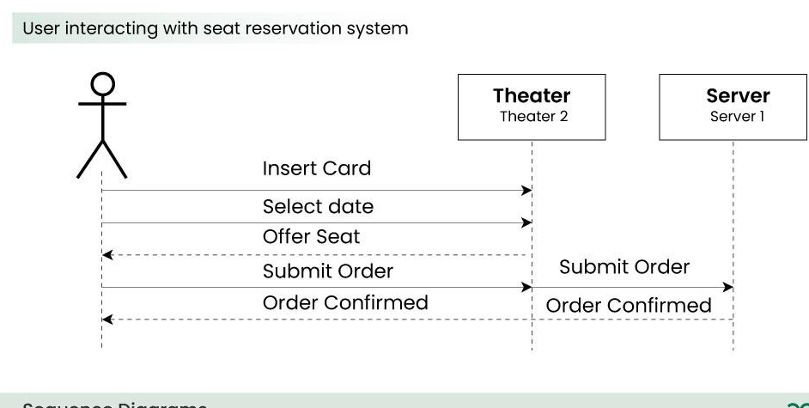
Sequence diagram…
"Copyright Practical OO Analysis, Thomson Publishing, 2005".

Slide 7
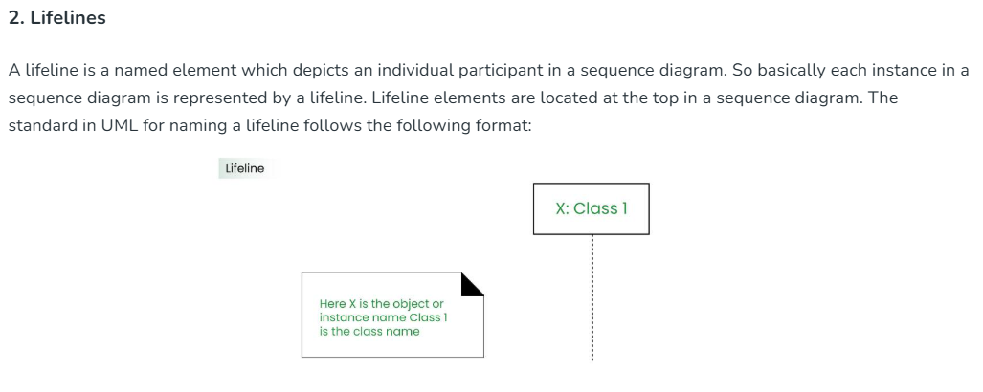
"Copyright Practical OO Analysis, Thomson Publishing, 2005".

Slide 8
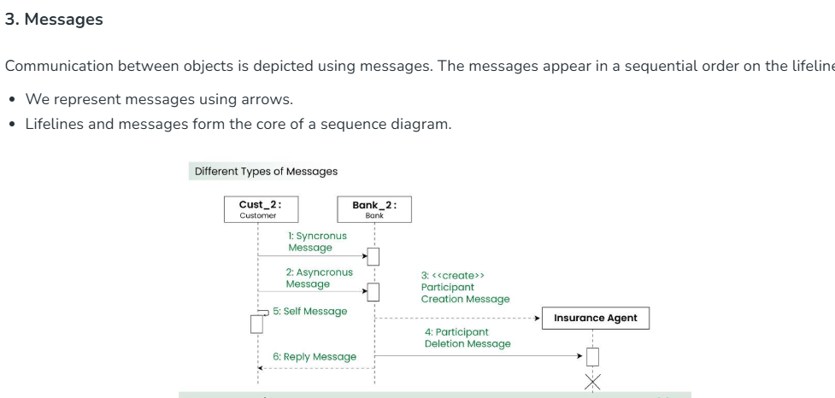
"Copyright Practical OO Analysis, Thomson Publishing, 2005".

Slide 9
Synchronous messages
A synchronous message waits for a reply before the interaction can move forward. The sender waits until the receiver has completed the processing of the message. The caller continues only when it knows that the receiver has processed the previous message i.e. it receives a reply message.
A large number of calls in object oriented programming are synchronous.
We use a solid arrow head to represent a synchronous message.
"Copyright Practical OO Analysis, Thomson Publishing, 2005".

Slide 10
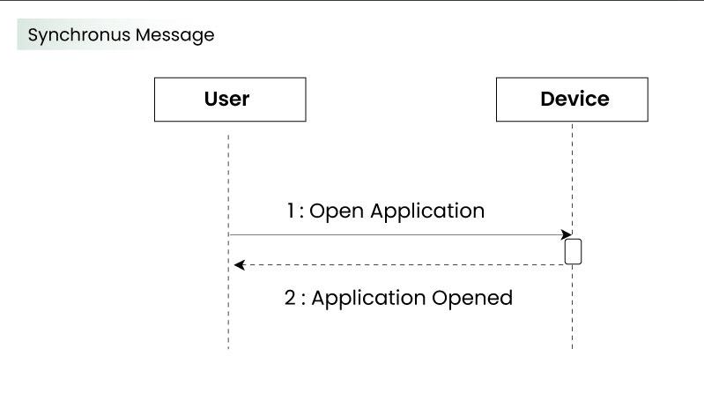
"Copyright Practical OO Analysis, Thomson Publishing, 2005".

Slide 11
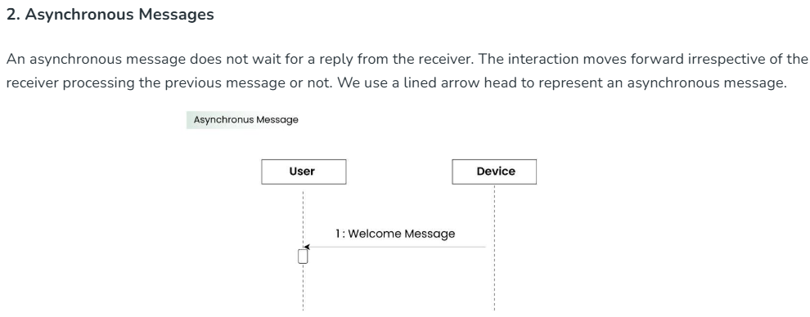
"Copyright Practical OO Analysis, Thomson Publishing, 2005".

Slide 12
Self Message
Certain scenarios might arise where the object needs to send a message to itself. Such messages are called Self Messages and are represented with a U shaped arrow.
"Copyright Practical OO Analysis, Thomson Publishing, 2005".

Slide 13
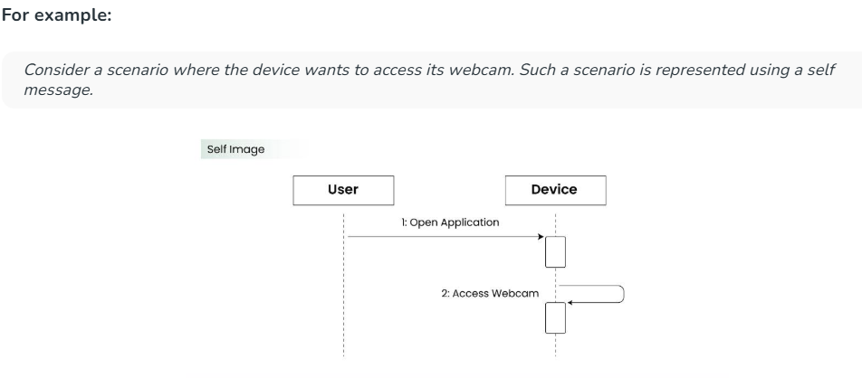
"Copyright Practical OO Analysis, Thomson Publishing, 2005".

Slide 14
Alternatives
Alternatives are used to designate a mutually exclusive choice between two or more message sequences. (Note: It is indeed possible for two or more guard conditions attached to different alternative operands to be true at the same time, but at most only one operand will actually occur at run time (which alternative "wins" in such cases is not defined by the UML standard).) Alternatives allow the modeling of the classic "if then else" logic (e.g., if I buy three items, then I get 20% off my purchase; else I get 10% off my purchase).
As you will notice in Figure 8, an alternative combination fragment element is drawn using a frame. The word "alt" is placed inside the frame's namebox. The larger rectangle is then divided into what UML 2 calls operands. (Note: Although operands look a lot like lanes on a highway, I specifically did not call them lanes. Swim lanes are a UML notation used on activity diagrams.) Operands are separated by a dashed line. Each operand is given a guard to test against, and this guard is placed towards the top left section of the operand on top of a lifeline. (Note: Usually, the lifeline to which the guard is attached is the lifeline that owns the variable that is included in the guard expression.) If an operand's guard equates to "true," then that operand is the operand to follow.
"Copyright Practical OO Analysis, Thomson Publishing, 2005".

Slide 15
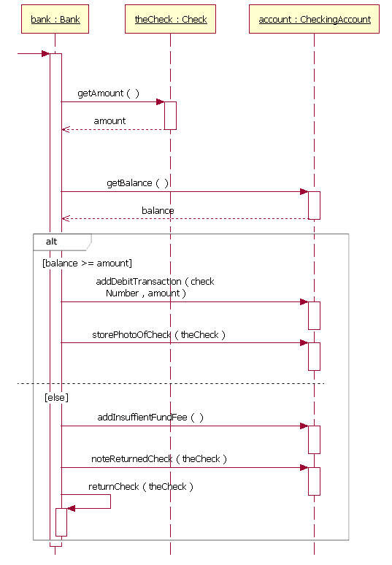
"Copyright Practical OO Analysis, Thomson Publishing, 2005".

Slide 16
Sub-module
Sequence diagrams for hospital management system
"Copyright Practical OO Analysis, Thomson Publishing, 2005".

Slide 17
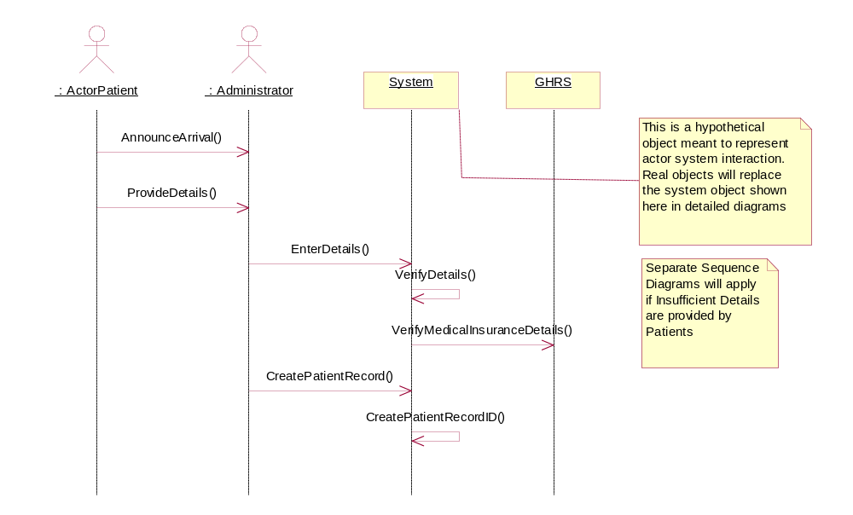
“Registering a Patient “ Sequence Diagram
"Copyright Practical OO Analysis, Thomson Publishing, 2005".

Slide 18
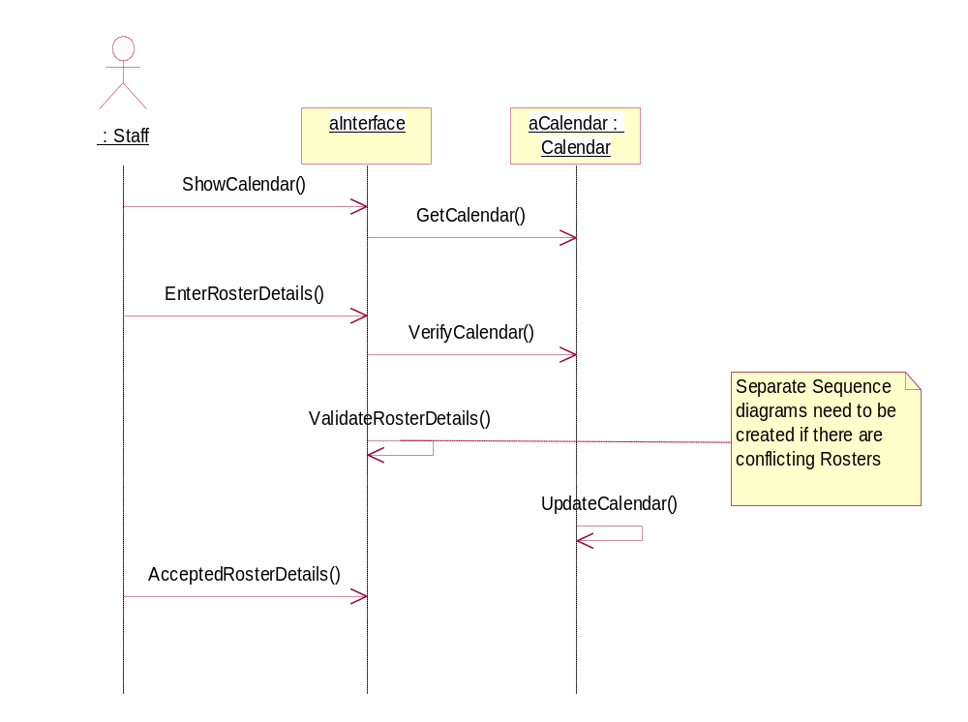
“Updating a Calendar“ Sequence Diagram
"Copyright Practical OO Analysis, Thomson Publishing, 2005".

Slide 19
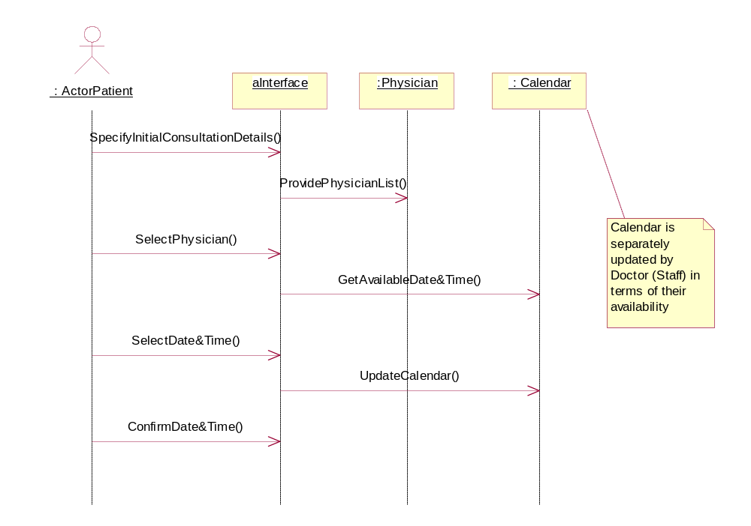
“Booking a Consultation “ Sequence Diagram
"Copyright Practical OO Analysis, Thomson Publishing, 2005".

Slide 20
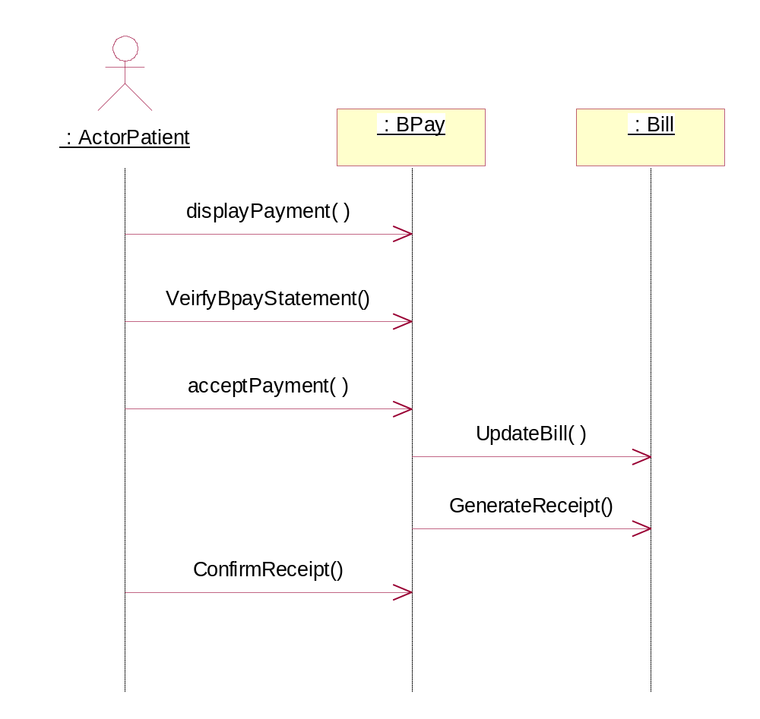
“Paying a Bill “ Sequence Diagram
"Copyright Practical OO Analysis, Thomson Publishing, 2005".

Slide 21
Relating Sequence Diagrams to Class Diagrams
Objects on Sequence Diagrams belong to Classes in Class Diagram
aPatient:
Patient
Patient
1: checkPatientDetails( )
checkPatientDetails( )
Messages on Sequence Diagrams come from Methods available to the Class on Class Diagrams
"Copyright Practical OO Analysis, Thomson Publishing, 2005".

Slide 22
SWOT of a Sequence Diagram
STRENGTHS:
Show the dynamic behavior
of the system
Show a set of collaborating
objects, messages passing
between them, and timing
Ideal “snap shot” representation
of ‘what happens’
WEAKNESSES:
Snapshots, hence incomplete
Presents behavior, but still not
considered truly Dynamic by many
OBJECTIVES:
Show the interaction between Actor and system
typically as an ‘example’ within a use case
Show the message passing between
collaborating objects, or system and actor
Messages with their signatures provide direct
information to programmers
Mechanism to help users build storyboards
Mechanism to discover Classes and Methods
TRAPS:
Attempting to show a ‘complete’ sequence is
a major trap – do not try to complete a seq.diagram
Inappropriate level of usage (BA trying
technical, and vice versa)
"Copyright Practical OO Analysis, Thomson Publishing, 2005".

Slide 23
Conclusions
Sequence diagrams in
  Interaction between Collaborating Objects
  Interaction between Actors and System.
Naming an interaction overview diagram
State machine diagrams show various states of the object during its lifecycle.
"Copyright Practical OO Analysis, Thomson Publishing, 2005".

Slide 24
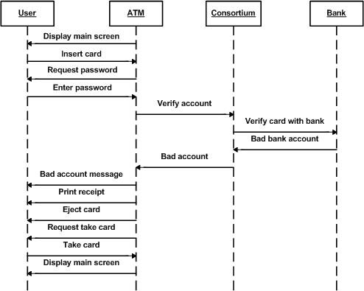
Atm sequence diagram
"Copyright Practical OO Analysis, Thomson Publishing, 2005".

Slide 25
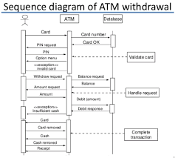
"Copyright Practical OO Analysis, Thomson Publishing, 2005".

Slide 26
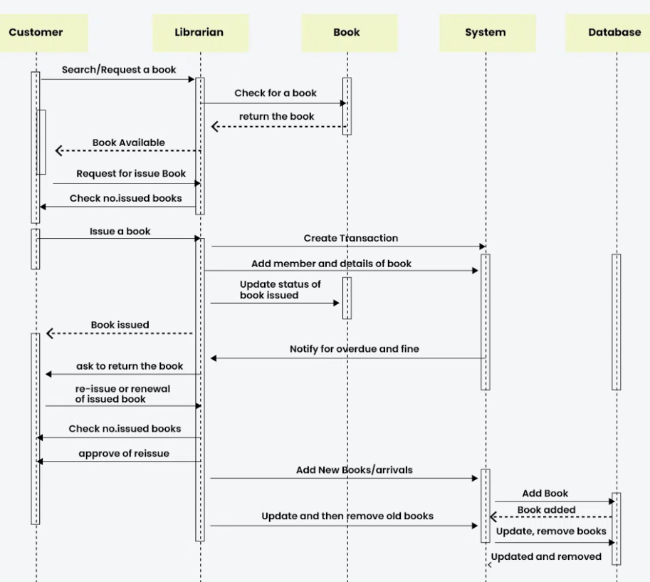
"Copyright Practical OO Analysis, Thomson Publishing, 2005".

